Slide 1
Community Detection
based on Distance Dynamics
Reporters:
Shixuan Sun, Yulin Che

Slide 2
Content
1、Background
2、Attractor Model
3、Evaluation
4、Problem & Improvement
5、Conclusion & Insight
2

Slide 3
Content
1、Background
2、Attractor Model
3、Evaluation
4、Problem & Improvement
5、Conclusion & Insight
2

Slide 4
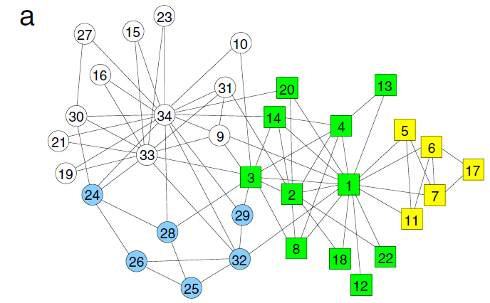
1、Background
Community Detection
Community structure : If the nodes of the network can be easily grouped into sets of nodes such that each set of nodes is densely connected internally as a community/cluster.
Community detection : Extract community structure from graph.
2
Zachary's karate club, a standard benchmark in community detection.

Slide 5
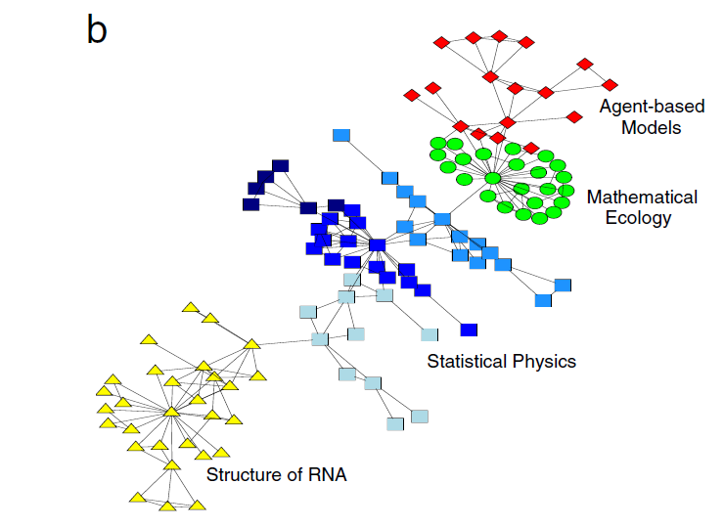
1、Background
Application – Collaboration
Collaboration network between scientists working at the Santa Fe Institute
2

Slide 6
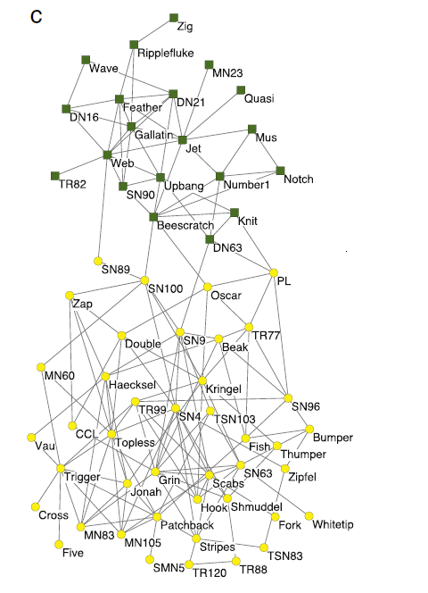
1、Background
Application – Biology
2
Lusseau's network of bottlenose dolphins

Slide 7
1、Background
Existing Algorithms
Algorithm Type | Algorithm Representatives
Partition-based | Metis
Hierarchical based | Louvain
Information-based | Infomap
Dynamic algorithms | Markov Clustering (MCL)
Divisive clustering | Girvan and Newman
Spectral clustering | Using eigenvectors of the Laplacian matrix
Modularity-based | Modularity-based greedy, modularity-based simulated-annealing
Statistical inference | Methods adopting Bayesian inference , in which the best fit is obtained through the maximization of a
In our project, we choose Metis, Louvain, Infomap, MCL for comparison with Attractor, the algorithm which we implemented and improved
2

Slide 8
Content
1、Background
2、Attractor Model
3、Evaluation
4、Problem & Improvement
5、Conclusion & Insight
2

Slide 9
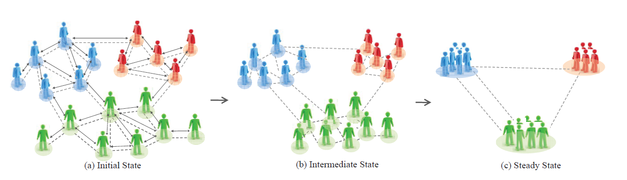
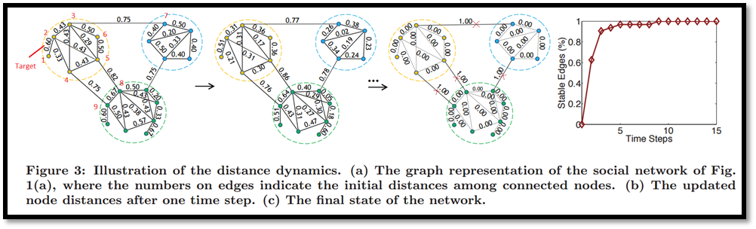
2、Attractor model
Overall Idea
2

Slide 10
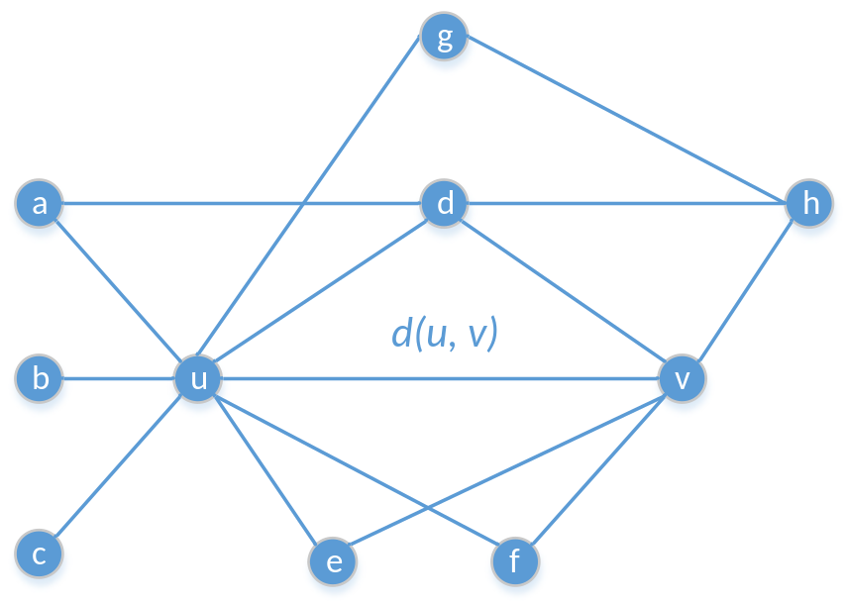

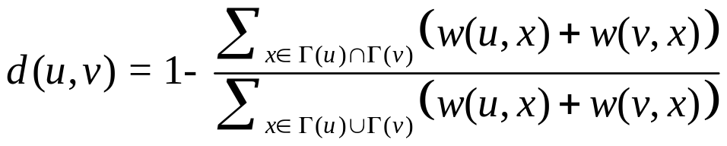
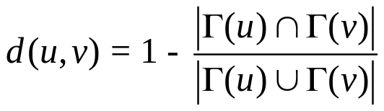
2、Attractor model
Definition
2

Slide 11
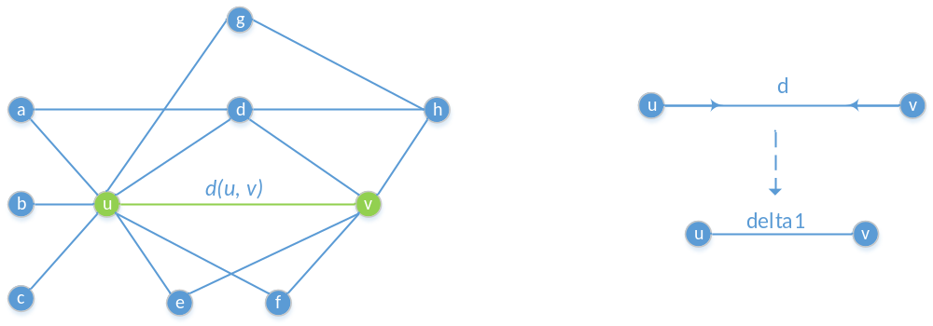
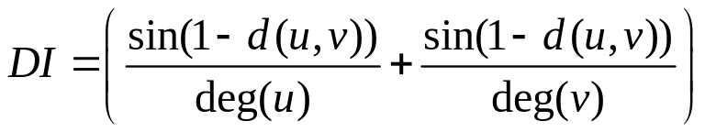
2、Attractor model
Directed Linked Nodes Influence
2

Slide 12
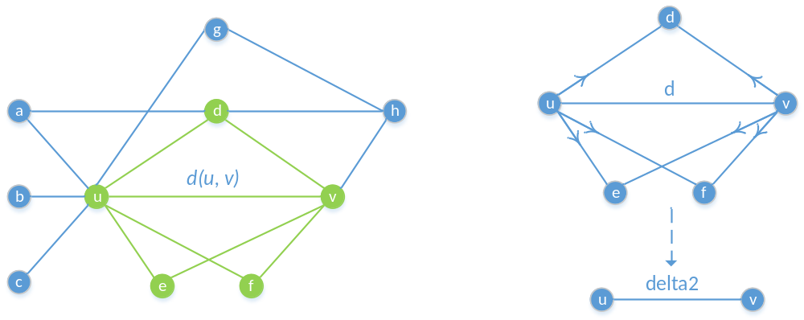
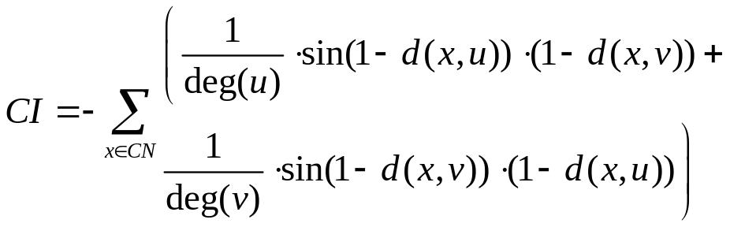
2、Attractor model
Common Neighbor Influence
2

Slide 13
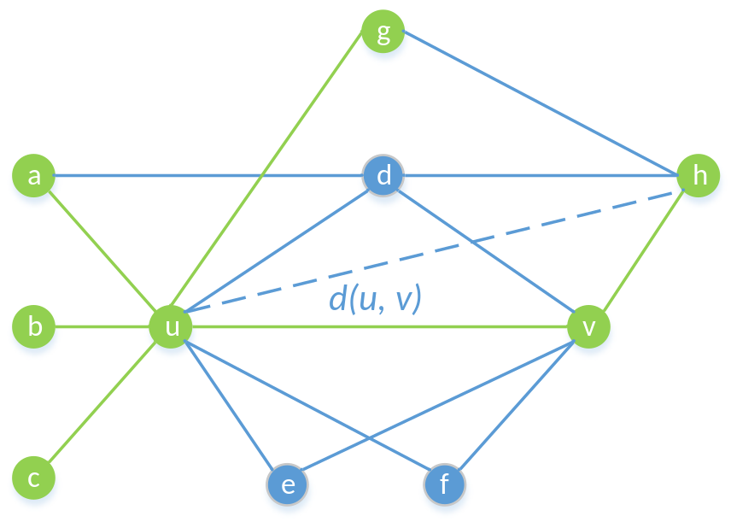
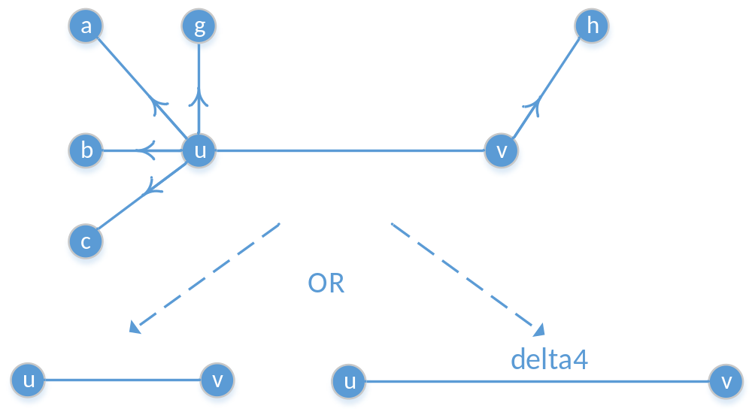
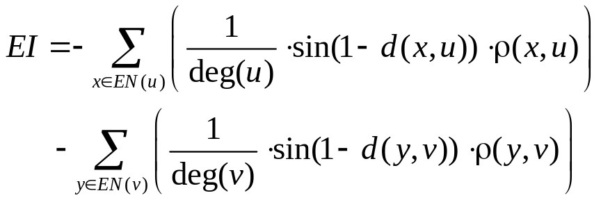
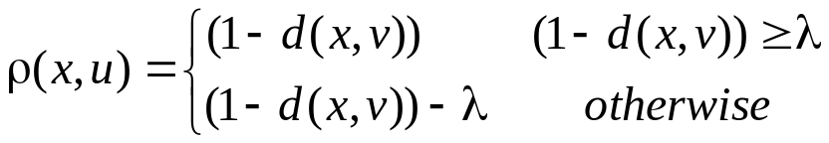
2、Attractor model
Exclusive Neighbor Influence
2

Slide 14
Content
1、Background
2、Attractor Model
3、Evaluation
4、Problem & Improvement
5、Conclusion & Insight
2

Slide 15
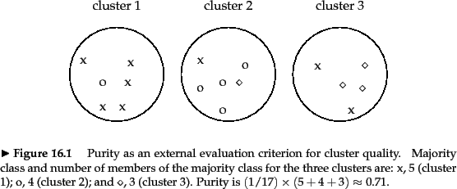
3、Evaluation
Measurement Criteria
With Ground truth
1) Purity & Inverse-purity
Purity: Regard community detection result as circles and ground truth as marks
Inverse - Purity: Regard ground truth as circles and community detection result as marks
http://www.cnblogs.com/ziqiao/archive/2011/12/13/2286273.html
2

Slide 16

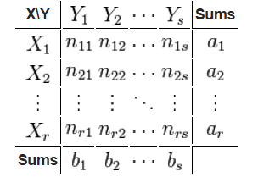

3、Evaluation
Measurement Criteria
With Ground truth
2) Adjusted Rand Index
Definition
Is a set of elements
The contingency table
is shown in contingency table
https://en.wikipedia.org/wiki/Rand_index
2

Slide 17

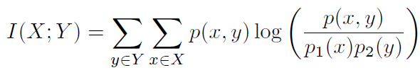

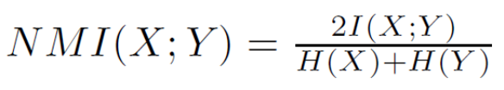
3、Evaluation
Measurement Criteria
With Ground truth
3) Normalized Mutual Information
Entropy: the information contained in a distribution
Mutual Information: the shared information between two distributions
Normalized Mutual Information (between 0 and 1)
Consider a partition as a distribution (probability of one node falling into one community), we can compute the matching between the clustering result and the ground truth
JMLR03, Strehl
KDD04, Dhilon
http://www.cc.gatech.edu/classes/AY2011/cs7270_spring/7270-community-detection.pptx
2

Slide 18
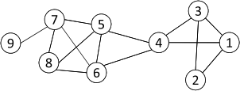


3、Evaluation
Measurement Criteria
Without Ground truth
1) Modularity
Modularity measures the strength of a community partition by taking into account the degree distribution
Given a network with m edges, the expected number of edges between two nodes with degrees d_{i} and d_{j} is
Strength of a community:
Modularity:
A larger value indicates a good community structure
The expected number of edges between nodes 1 and 2 is
3*2/ (2*14) = 3/14
Given the degree distribution
2
http://www.cc.gatech.edu/classes/AY2011/cs7270_spring/7270-community-detection.pptx

Slide 19
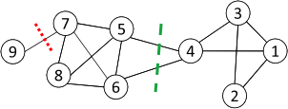

3、Evaluation
Measurement Criteria
Without Ground truth
2) Normalized Cut
Minimum cut often returns an imbalanced partition, with one set being a singleton, e.g. node 9
Change the objective function to consider community size
C_{i,}: a community
|C_{i}|: number of nodes in C_{i}
vol(C_{i}): sum of degrees in C_{i}
http://www.cc.gatech.edu/classes/AY2011/cs7270_spring/7270-community-detection.pptx
2

Slide 20
3、Evaluation
Benchmark Dataset
1) Small dataset with ground truth
Dataset Name | Description
Karate | A network of friendships between the 34 members of a karate club at a US university.
Polbooks | A network where nodes represent books about US politics sold by the online bookseller Amazon.com, and edges represent frequent co-purchasing of books by the same buyers.
Football | A network of American football games between Division IA colleges during regular season Fall 2000.
http://networkdata.ics.uci.edu/data/
2

Slide 21
3、Evaluation
Benchmark Dataset
2) Real world dataset without ground truth
Dataset Name | Description
Amazon | A network consisting of 334,863 edges and 925,872 nodes. Each node represents a product on the Amazon website.
Collaboration | A collaboration network of 9,875 authors working on the theory of high energy physics.
Friendship | A location based friendship network consisting of 58,228 nodes and 214,078 edges.
Road | A network reflecting Pennsylvania road structure, where nodes represents endpoints and edges represent the roads.
2
http://snap.stanford.edu/data/index.html

Slide 22
3、Evaluation
Benchmark Dataset
3) Synthetic dataset with ground truth
Dataset Generator Type | Description
Relaxed Caveman Graph | A relaxed caveman graph starts with l cliques of size k. Edges are then randomly rewired with probability p to link different cliques.
Random Partition Graph | A graph of communities with sizes defined by s in sizes. Nodes in the same group are connected with probability p_in and nodes of different groups are connected with probability p_out.
Gaussian Random Partition Graph | A Gaussian random partition graph is created by creating k partitions each with a size drawn from a normal distribution with mean s and variance s/v. Nodes are connected within clusters with probability p_in and between clusters with probability p_out.
http://networkx.github.io/documentation/latest/reference/generators.html?highlight=generator
2

Slide 23
3、Evaluation
Result Analysis
Three Graph Clustering Algorithms for comparison
Algorithm | Description
Markov Cluster Algorithm(MCL) | The MCL algorithm is short for the Markov Cluster Algorithm, a fast and scalable unsupervised cluster algorithm for graphs (also known as networks) based on simulation of (stochastic) flow in graphs
Infomap | Infomap optimizes the map equation, which exploits the information-theoretic duality between the problem of compressing data, and the problem of detecting and extracting significant patterns or structures within those data.
Louvain | Louvain is a hierarchy based graph clustering method. First, it looks for "small" communities by optimizing modularity in a local way. Second, it aggregates nodes of the same community and builds a new network whose nodes are the communities. These steps are repeated iteratively until a maximum of modularity is attained.
2

Slide 24
3、Evaluation
Result Analysis
1) Result analysis for small dataset with ground truth
 | Karate |  |  | Football |  |  | Polbooks
 | NMI | ARI | Purity | NMI | ARI | Purity | NMI | ARI | Purity
Attractor | 0.924 | 0.939 | 2.030 | 0.945 | 0.929 | 2.160 | 0.592 | 0.692 | 2.391
MCL | 0.836 | 0.882 | 2.061 | 0.924 | 0.897 | 2.160 | 0.521 | 0.594 | 2.496
Infomap | 0.924 | 0.897 | 2.224 | 0.924 | 0.897 | 2.160 | 0.537 | 0.646 | 2.460
Louvain | 0.885 | 0.803 | 2.478 | 0.885 | 0.803 | 2.335 | 0.522 | 0.537 | 2.476
We use NMI, ARI, F-measure purity as measurement criteria.
Note: Yellow blocks indicate better quality of graph clustering.
2

Slide 25
3、Evaluation
Result Analysis
2) Result analysis for real world dataset without ground truth
 | Collaboration |  |  | Friendship
 | #cluster | Mod | Ncut | #cluster | Mod | Ncut
Attractor | 1246 | 0.590 | 0.307 | 8046 | 0.422 | 0.607
MCL | 2093 | 0.537 | 0.411 | 13788 | 0.319 | 0.602
Infomap | 1337 | 0.652 | 0.231 | 5134 | 0.551 | 0.374
Louvain | 473 | 0.768 | 0.015 | 706 | 0.683 | 0.034
 | Amazon |  |  | Road
 | #cluster | Mod | Ncut | #cluster | Mod | Ncut
Attractor | 23822 | 0.741 | 0.398 | 56967 | 0.865 | 0.264
MCL | 46557 | 0.673 | 0.440 | 86745 | 0.810 | 0.214
Infomap | 35056 | 0.730 | 0.321 | 189360 | 0.720 | 0.297
Louvain | 234 | 0.926 | 0.036 | 491 | 0.989 | 0.004
2
We use #cluster, modularity, normalized cut as measurement criteria.

Slide 26
Content
1、Background
2、Attractor Model
3、Evaluation
4、Problem & Improvement
5、Conclusion & Insight
2

Slide 27
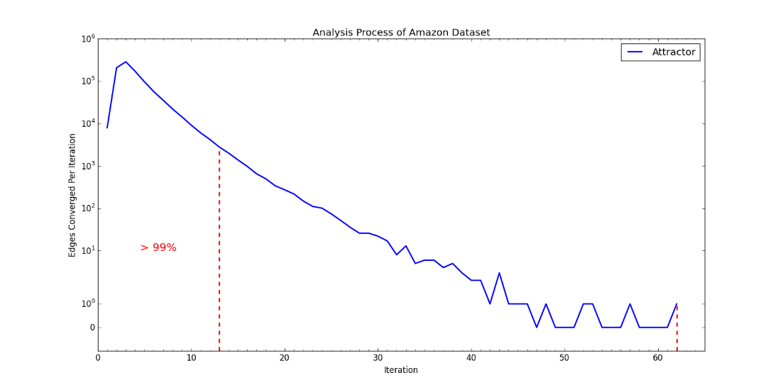
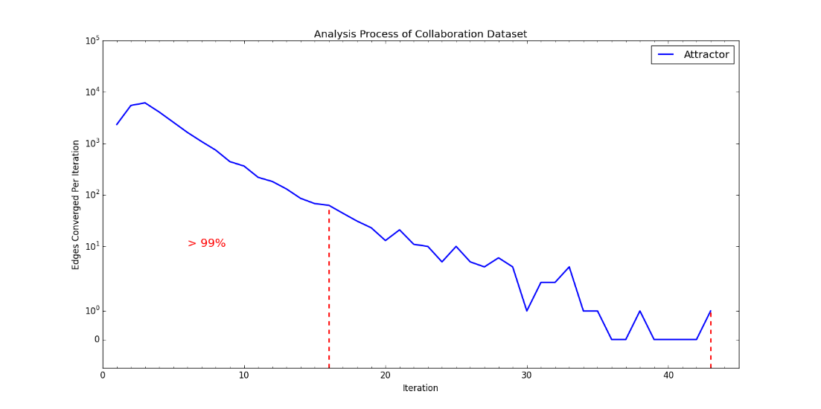
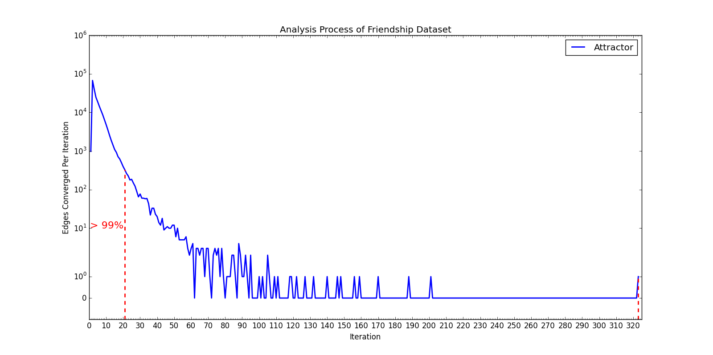
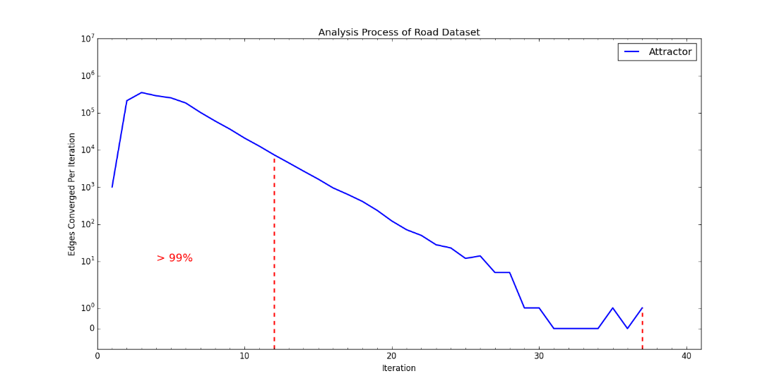
4、Problem
Long Converge Tailor
a) Converge diagram on Amazon
b) Converge diagram on Collboration
2
c) Converge diagram on Friendship
d) Converge diagram on Road

Slide 28
4、Solution
Sliding Window
Analysis: some vertices are appealed by different potential communities, their converging speed is low. We want to increase or amplify the effect of appealing influence without much affecting the procedure of convergence.
Besides, if we introduce another parameter to amplify delta distance of edge, it will be hard to normalize it.
Solution:
Sliding Window Structure: Every edge contains an sliding window to record its latest converging trend with an appropriate size and support factor. In our project, its default size is 10, users can tune the parameter.
Two operations :
1) add marks about distance change of edge in current iteration, i.e, 1 indicates increase and 0 indicates decrease.
2) judge the trend of convergence of edge, i.e., according to the latest change, after comparing it with other former (window size -1) changes, if the count of this trend exceeds (support factor * window size), we think the edge will converge with this trend, at set its distance 0 if it is decreasing, otherwise 1.
2

Slide 29
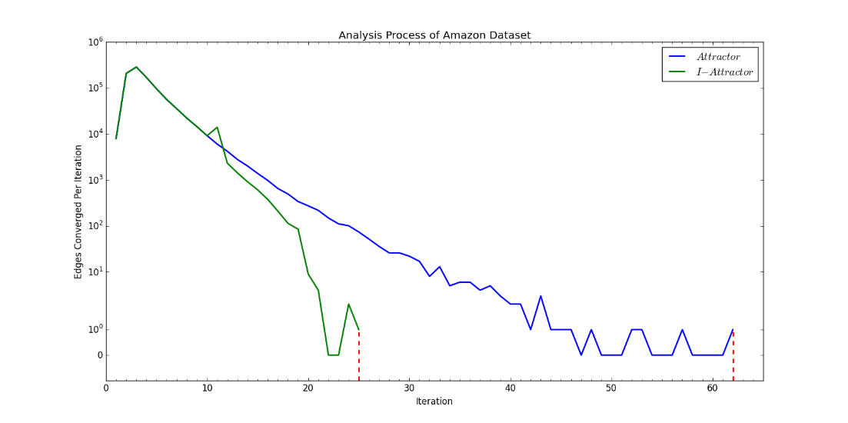
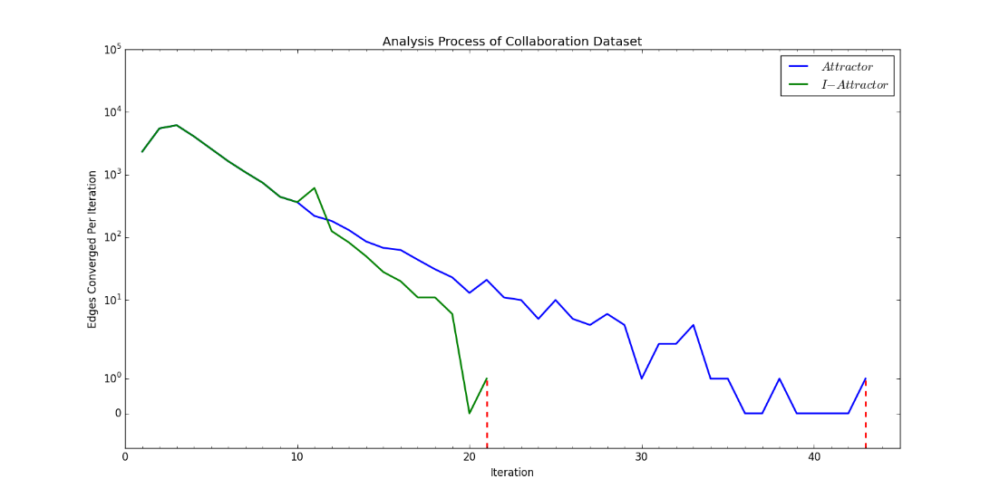
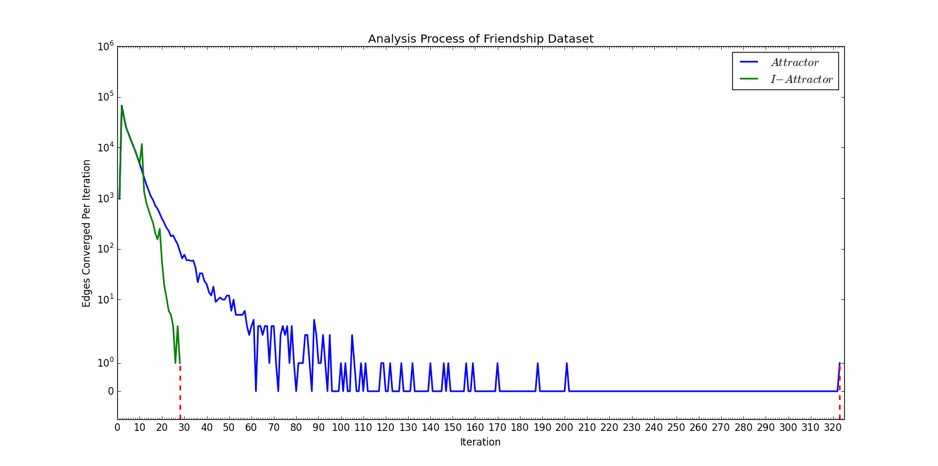
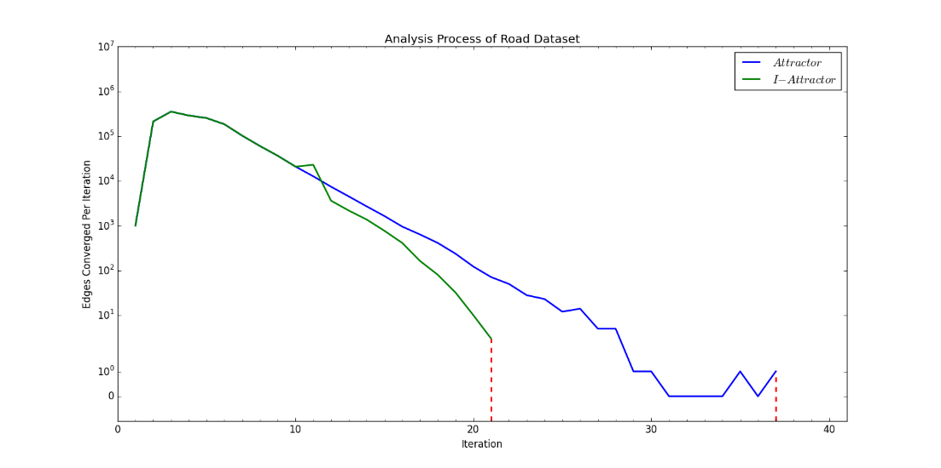
4、Improvement
Experimental Result
a) Converge comparison diagram on Amazon
b) Converge comparison diagram on Collaboration
2
c) Converge comparison diagram on Friendship
d) Converge comparison diagram on Road

Slide 30
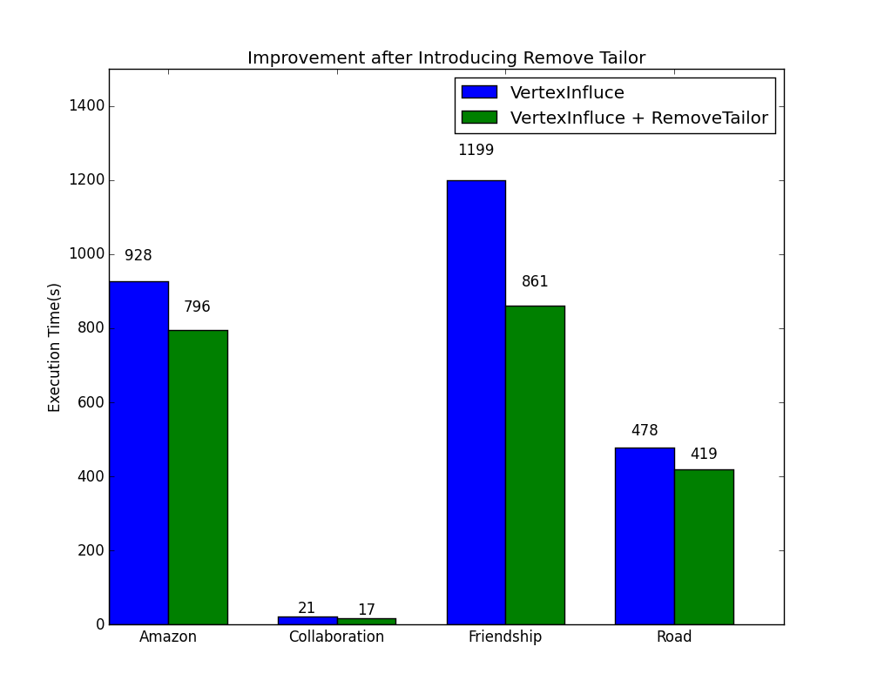
4、Improvement
Experimental Result
 | Only VertextInfluence | After RemoveTailor | Time Redcution
Amazon | 928s | 796s | 14.2%
Collaboration | 21s | 17s | 19.0%
Friendship | 1199s | 861s | 28.2%
Road | 478s | 419s | 12.3%
2

Slide 31
Content
1、Background
2、Attractor Model
3、Evaluation
4、Problem & Improvement
5、Conclusion & Insight
2

Slide 32
Q & A
Thanks for listening！

